Slide 1
Supporting young people to find employment
Strengths and Employability Skills

Slide 2
Employer Expectations

Slide 3
Employability skills
Thinking Skills
Communication
Willingness to Learn
Time Management
Resilience
Positive Attitude
Self-management
Teamwork
Problem Solving

Slide 4
What does the data say?
Employers
Young People
72%
VS
32%
of responding employers in the Department of Employment, skills, small and family businesses 2018 Survey valued skills such as punctuality, professionalism, good communication, personal presentation and teamwork over technical skills
of young people in an Indeed study
feared not having enough relevant experience to apply for a role.

Slide 5
Which skills are more important to you when making a recruitment decision?
11
6
7
6
6
5
3
2
2
2
1
1
0
0
0
0
Employability Skills*
Technical Skills
Literacy Skills
Numeracy Skills
# 1 priority skills
# 2 priority skills
# 3 priority skills
# 4 priority skills

Slide 6
What employability skills would you like to see applicants leave school with? (Top 3)
Notes:
Motivation and work ethic were often measured by participation in part-time work and membership of sporting or extra-curricular clubs over extended periods of time.
Industry interest was also popular. Employers felt that a candidate with an industry passion would put in the effort to learn a role and be reliable and likely to stay with their business.
Employers gauged people skills and attitude by their initial interactions with candidates.

Slide 7
Tips to build employability skills include:
group based projects to foster teamwork skills
written assignments and working in customer service to foster communication skills
learning about problem solving techniques to foster independence
(www.youthcentral.vic.gov.au)

Slide 8
Recognise our value
Young people often don’t recognise the value of what they do
Confidence can be low- we need to change that
Cohort of young people with NO opportunity for work experience
Be the difference

Slide 9
Change our behaviour
Talk about employability skills
Lead by example- set the standard
Highlight examples
Encourage and acknowledge in day to day activities

Slide 10
Employability skills on a resume
Don’t just list the skill, provide an example
Focus on what we CAN do
Look at a job advertisement, what is the employer looking for?
Acknowledge paid and unpaid experience

Slide 11
Where can skills come from?
Source: https://www.youthcentral.vic.gov.au/sites/default/files/YouthCentral_Resume-VCE-No-Work-Exp_Jan2015.pdf

Slide 12
Strategies:
Don’t just list the skill, provide an example
Focus on what we CAN do
Look at a job advertisement, what is the employer looking for?
Acknowledge paid and unpaid experience

Slide 13
Example:
Source: https://www.youthcentral.vic.gov.au/sites/default/files/YouthCentral_Resume-VCE-No-Work-Exp_Jan2015.pdf

Slide 14
COVID Impact and Recovery

Slide 15
Resources

Slide 16
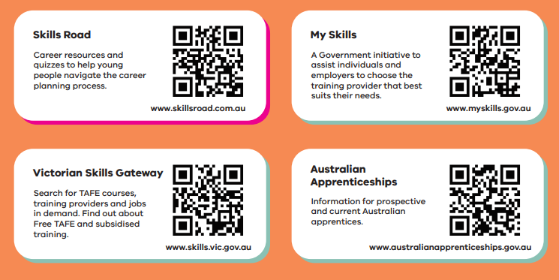
Resources

Slide 17
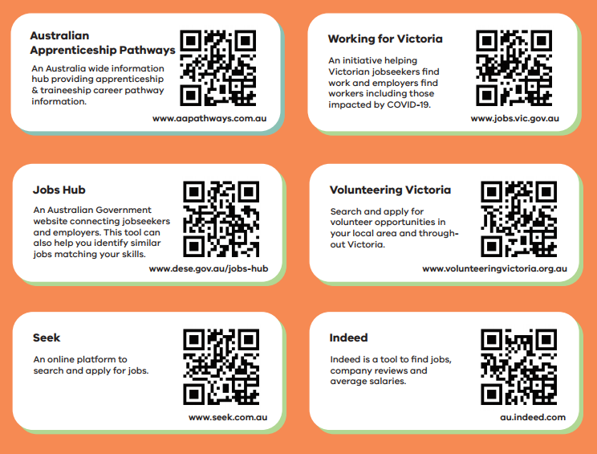
Resources

Slide 18
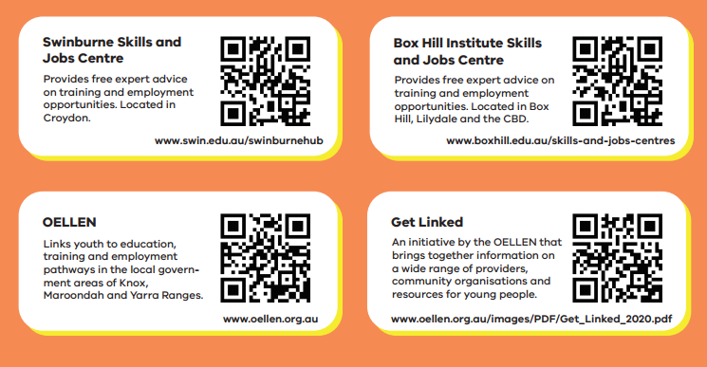
Resources

Slide 19
Resources:

Slide 20
Support:
You can access the Skills & Jobs Centres at Box Hill Institute by:
8892 1350
sajc.elgar@boxhill.edu.au
boxhill.edu.au/events/skills-and-jobs-centre-bookings/

